Slide 1

College Recommendation System
Group-6

Slide 2

AGENDA OVERVIEW
Introduction
Helps students choose the right college after school
Solves confusion caused by too many options
Suggests colleges based on marks, interests, and preferences
Saves time and effort in decision-making
Provides simple, personalized recommendations
Aims to guide students toward better academic choices

Slide 3

AGENDA OVERVIEW
Project Goals
Purpose: Helps students choose the right college and course
Smart Recommendation: Uses AI to suggest colleges
Input Factors: Considers exam scores, location preference, budget, course interests, and more
Personalized Output: Provides a ranked list of suitable colleges
Time-Saving: Reduces the confusion and time spent researching
Student-Centric: Empowers students to make informed decisions

Slide 4
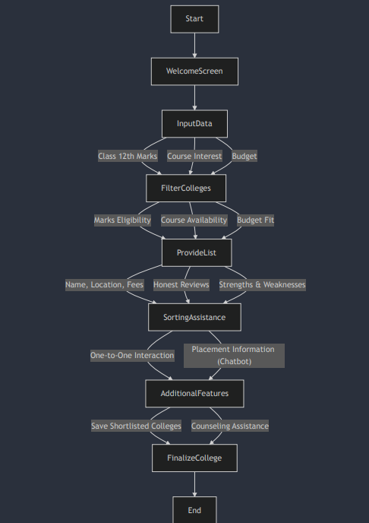
Architecture Diagram

Slide 5

Key Features
Personalized Recommendations
Multiple Input Factors
College Search & Filtering
Quick & Easy Interface
Course-Based Suggestions
Accessible Anywhere

Slide 6
Novelty
All-in-One Platform – Combines course, college, and preference matching in one place
Personalized Guidance – Tailors suggestions to each student’s unique profile.
Goal-Oriented Suggestions – Focuses on long-term academic and career fit

Slide 7



Technologies Used
JavaScript: The having base language for both
scripting and backend functionality.
HTML: Structures the content and layout of the web pages.
CSS: Styles the interface to make it visually a appealing and user-friendly.
COLLEGE RECOMMENDATION SYSTEM

Slide 8
Conclusion
This project offers a smart and accessible solution to assist students in selecting the appropriate college according to their own interests and academic history. With the help of web technologies such as HTML, CSS, and JavaScript, the site provides an easy, accessible, and interactive experience. Overall, the system is designed to minimize confusion, save time, and assist students in making wise decisions regarding their higher education.

Slide 9


TeamWork

Slide 10
Thank You

